Slide 1
Embodied Referring Expression for Manipulation Question Answering in Interactive Environment
Qie Sima, Sinan Tan, Huaping Liu
Tsinghua University

Slide 2
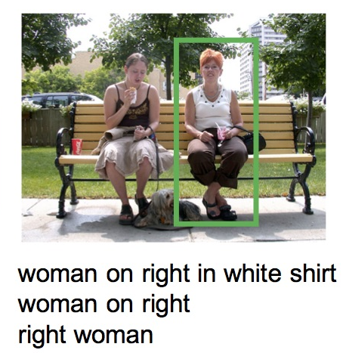
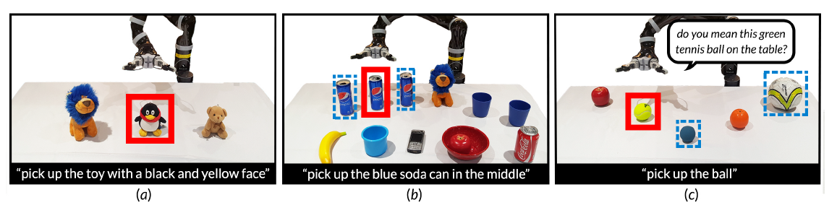
Introduction
The ability to actively interactive with surrounding environment to render more information is long anticipated by robot community.
Referring Expression Comprehension (REC) has been well studied on static dataset and transferred to embodied scenarios in recent years.
REC on static dataset
REC on embodied scenario
Notes:
Therefore, we introduce the new embodied task Embodied Remote Manipulation Question Answering (REMQA) where the agent is required to navigate to a remote position and perform manipulation to target object. Referring Expression Comprehension is adopted to localize object precisely.

Slide 3
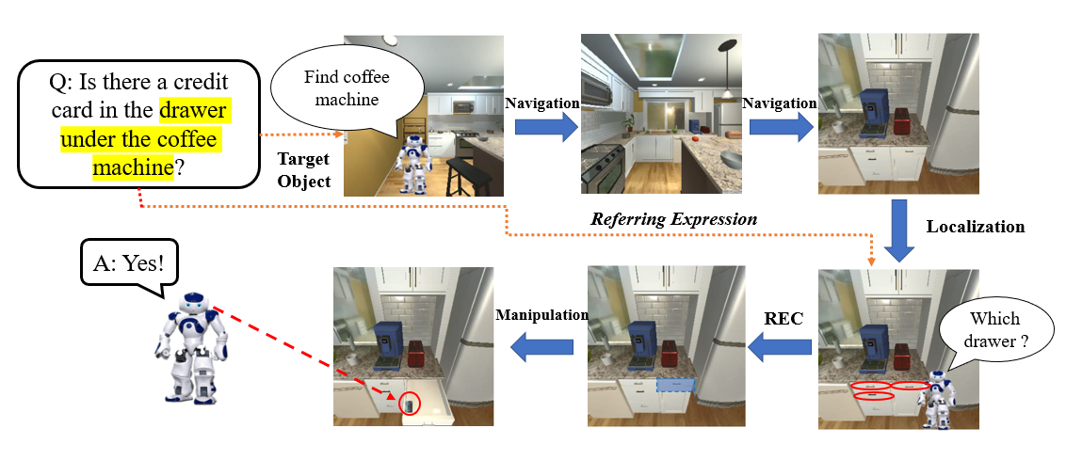
Introduction
We introduce a novel embodied task: Referring Expression for Manipulation Question Answering(REMQA)
the agent is required to navigate to a remote position and perform manipulation to target object. Referring Expression Comprehension is adopted to localize object precisely.
Notes:
Therefore, we introduce the new embodied task Embodied Remote Manipulation Question Answering (REMQA) where the agent is required to navigate to a remote position and perform manipulation to target object. Referring Expression Comprehension is adopted to localize object precisely.

Slide 4
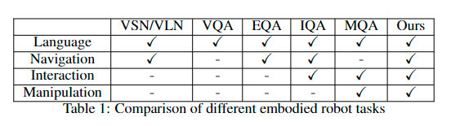
Motivation
We thoroughly investigate the offself embodied tasks on robot platforms and compare them with our proposed task from 4 modality: Language Comprehension, Active Navigation, Interaction and Manipulation

Slide 5
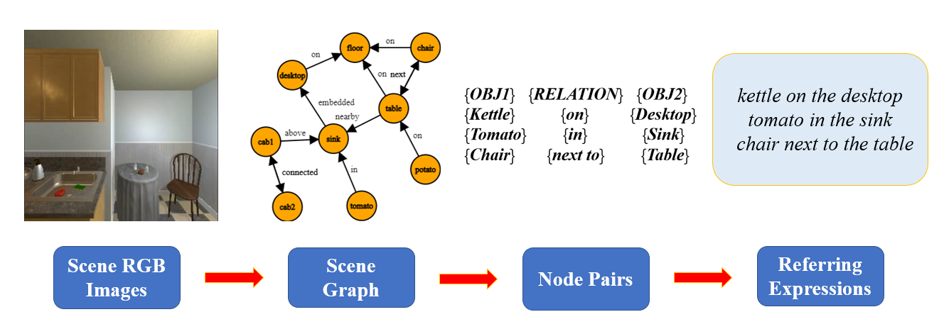
Dataset
We build the corresponding semantic scene graph incrementally from scene metadata during the sampling. Scene frames seen in the frame are sampled during navigation.
We add new objects as nodes and spatial relationship between objects as edges into scene graph.
The information in scene graphis used to create referring expressions

Slide 6
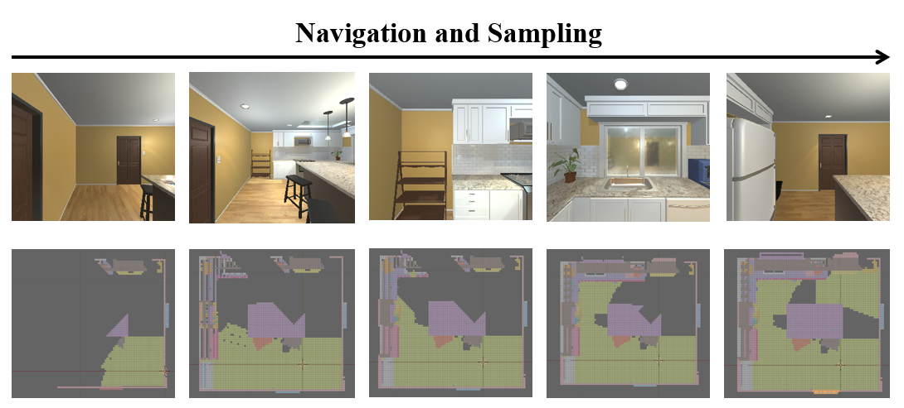
Model
To enhance the performance of navigation module with information of task scenarios, we build a knowledge-priored visual semantic navigation model based on scene graph and semantic map of given indoor environment.
The semantic map of task scene is incrementally built during sampling

Slide 7
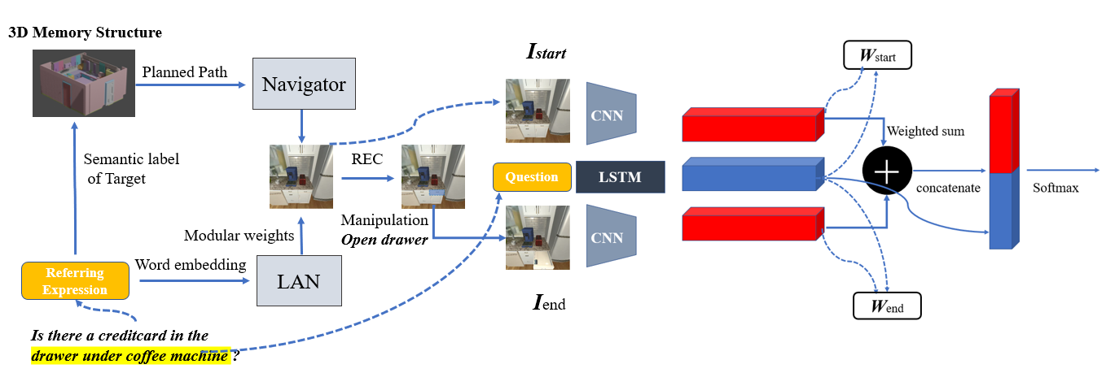
Model
Based on the form of REMQA tasks, we propose our framework to address this task
Three main parts of proposed model: 1) Visual Semantic Navigation module 2) Referring expression comprehension module 3) Manipulation Question Answering module.

Slide 8
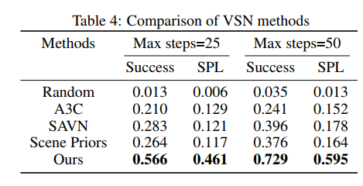
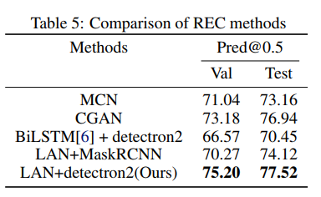
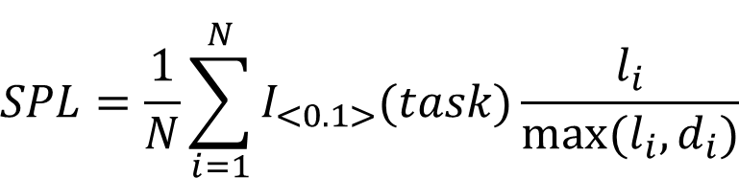
Experimental Results
In VSN stage, Taking advantage of the semantic map, our proposed navigation model outperforms all baseline methods in terms of both success rate and SPL metrics.
In REC stage, Our proposed REC model outperforms : MCN,CGAN and combinations of language parser and object detector with other backbones. on both validation and test set.
$$SPL=\frac{1}{N}\sum_{i=1}^{N}{I_{<0.1>}(task)\frac{l_{i}}{max⁡(l_{i},d_{i})}}$$

Slide 9
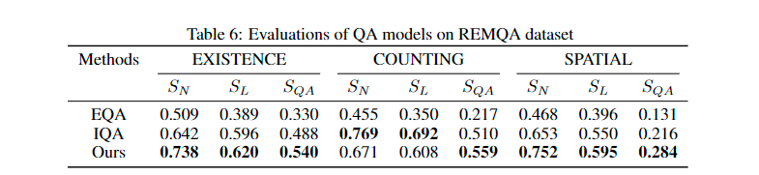
Experimental Results
We separately compare our navigation and comprehension results with the state-of-the-art methods(SoTAs) on our proposed benchmark dataset.
SN,SL,SQA denotes the ratio of samples successfully navigated to goal position, successfully localized at goal position(meaning referring expression comprehended for our model) and correctly answered out of all samples in REMQA dataset.
Our model outperforms EQA baseline in all 3 metrics and exceeds IQA in SQA . The margin in
SN SL may due to the shortcut in exploration ability of our scene-priored method

Slide 10
Experimental Results
To validate the effectiveness of our proposed model, we separately compare our navigation and comprehension results with the state-of-the-art methods(SoTAs) on our proposed benchmark dataset. The result are presented in Table. SN,SL,SQA denotes the ratio of samples successfully navigated to goal position, successfully localized at goal position(meaning referring expression comprehended for our model) and correctly answered out of all samples in REMQA dataset.

Slide 11
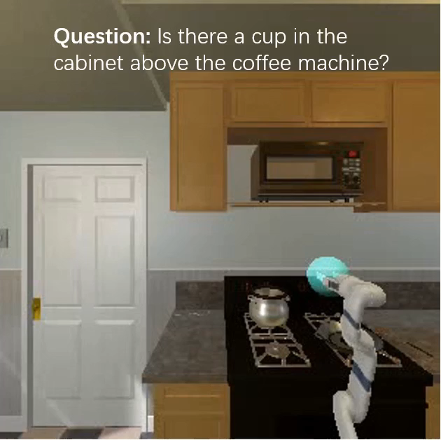
Experimental Results
A demo video of selected task episodes is presented
Question: Is there a cup in the cabinet above the coffee machine?
The manipulator agent successfully explore the room and find the cup at the end

